Slide 1




Lights, Camera, AI: Interactive Chat Bot
Brian Clark
clarkio.com
_clarkio
clarkio

Slide 2
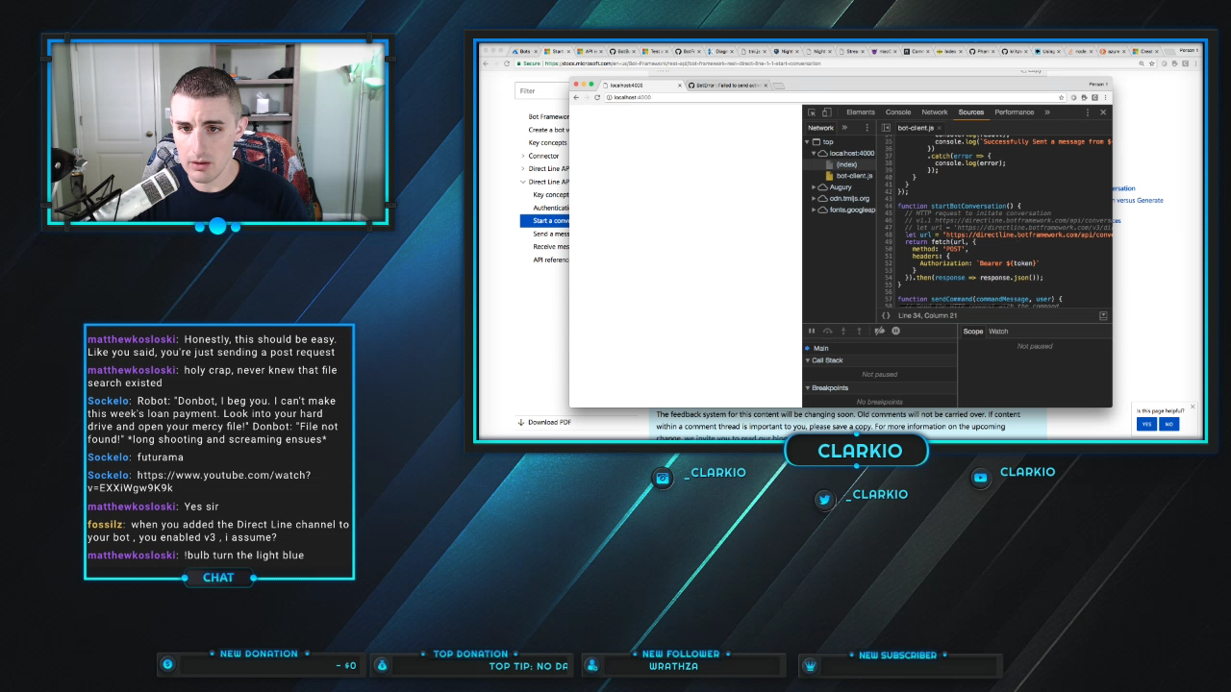

Slide 3
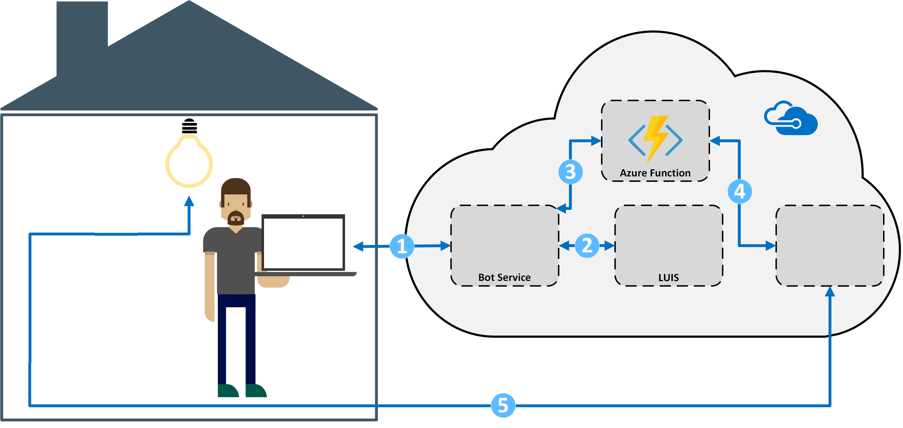

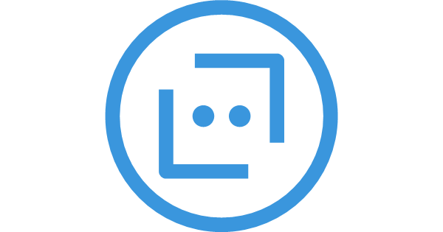
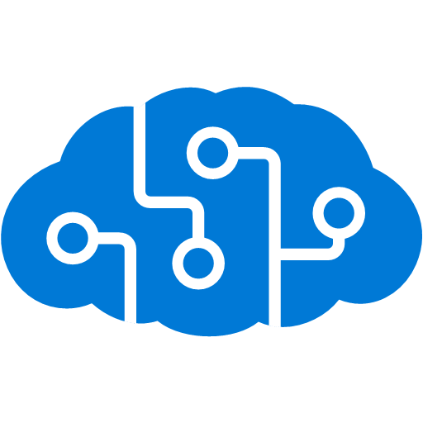



Slide 4
Outline
Lights
AI
Bots
Camera… oh my!

Slide 5
Lights

Slide 6
Lights

Slide 7
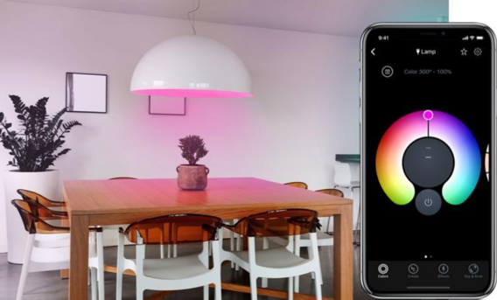
Lights

Slide 8
Lights

Slide 9
AI

Slide 10
AI

Slide 11
AI
Cognitive Services
LUIS

Slide 12
AI
Intent
The interpreted action requested by the end user/client

Slide 13
AI
Lights
The interpreted action requested by the end user/client

Slide 14
AI
Lights
Utterance
A form of saying an intent in human language

Slide 15
AI
Lights
Utterance
“Turn the light on”

Slide 16
AI
Lights
Utterance
“Change the light to blue”

Slide 17
AI
Lights
Utterance
Entity
“Turn the light on”

Slide 18
AI
Lights
Utterance
Entity
“Turn the light on”

Slide 19
AI
Lights
Utterance
Device
State
“Turn the light on”
“Turn the light on”

Slide 20
Demo

Slide 21
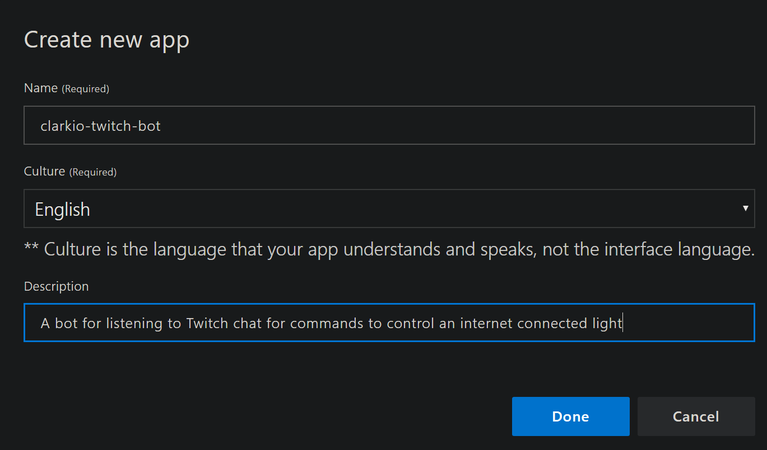
AI
1. Create an app at luis.ai

Slide 22
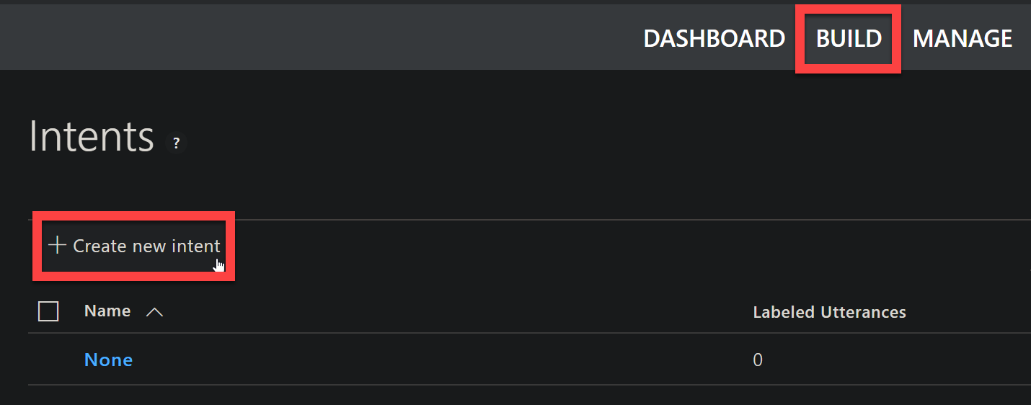
2. Create “Intents” to Build the AI
AI

Slide 23
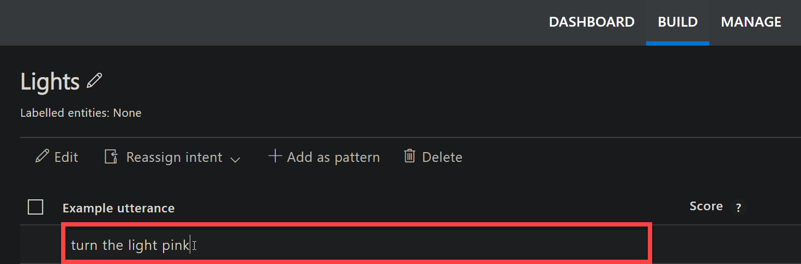
3. Add Utterances
AI

Slide 24
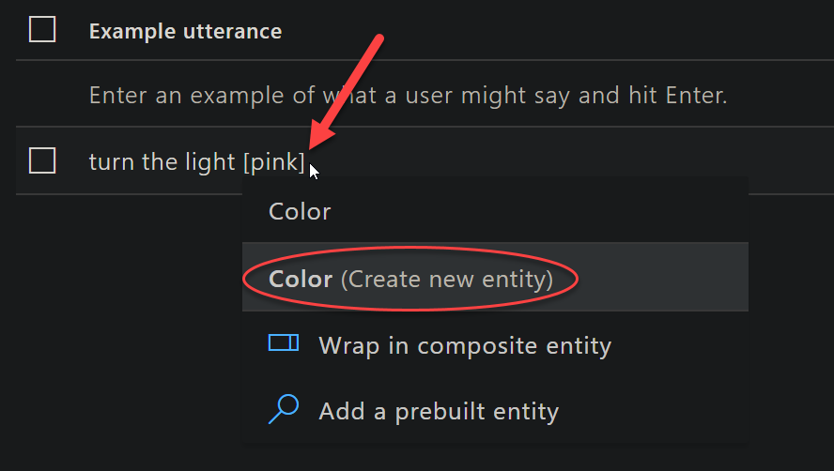
4. Identify Entities within Utterances
AI

Slide 25
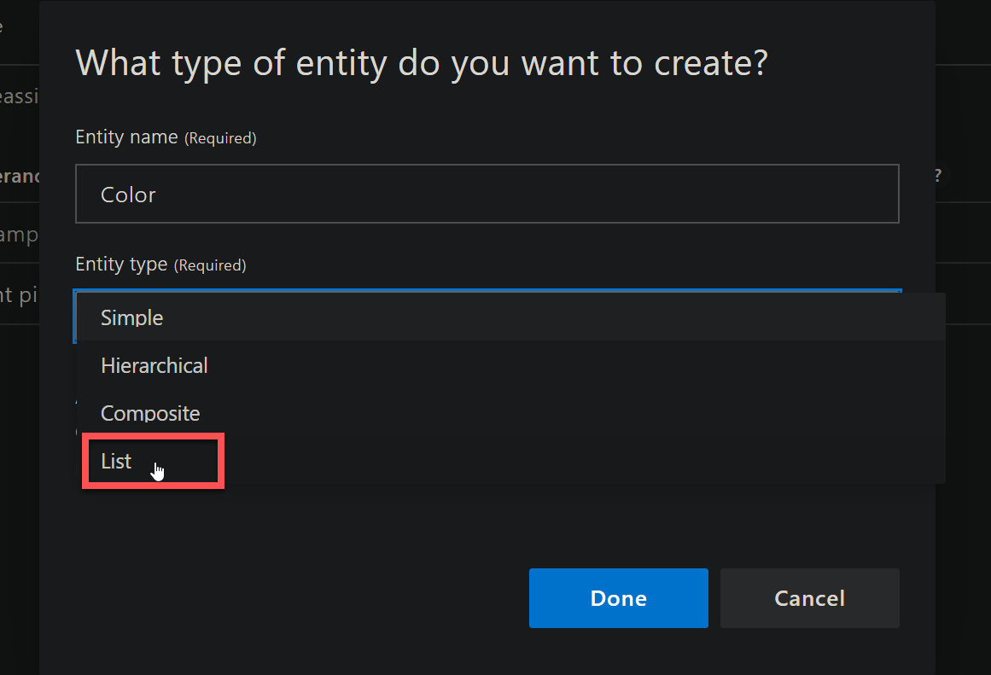
4. Identify Entities within Utterances
AI

Slide 26
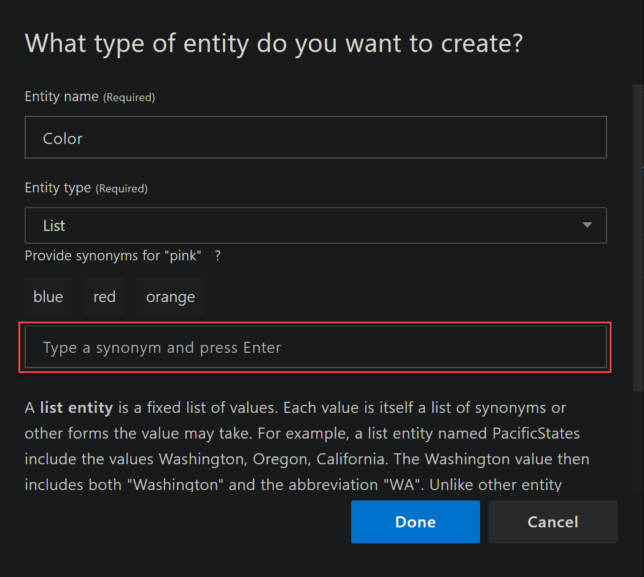
4. Identify Entities within Utterances
AI

Slide 27
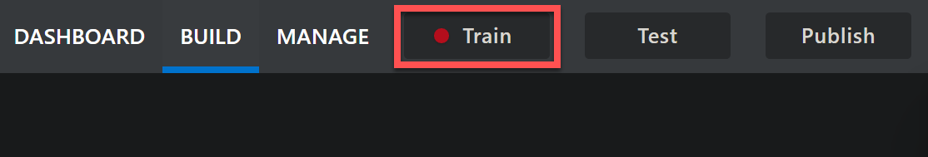
5. Train the AI
AI

Slide 28
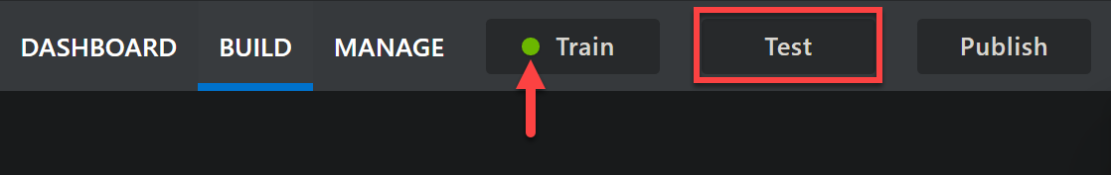
6. Test the AI
AI

Slide 29
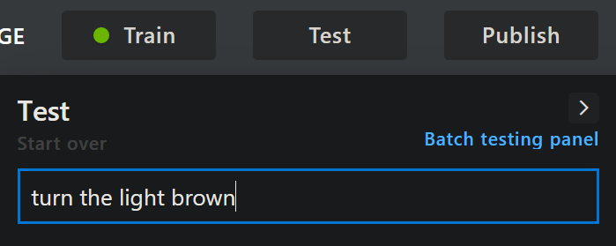
6. Test the AI
AI

Slide 30
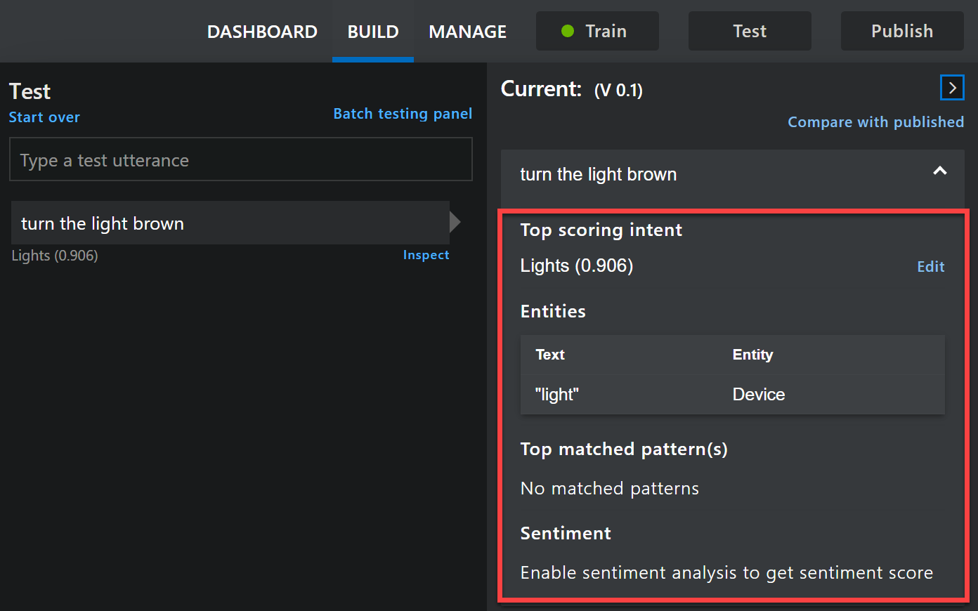
6. Test the AI
AI

Slide 31
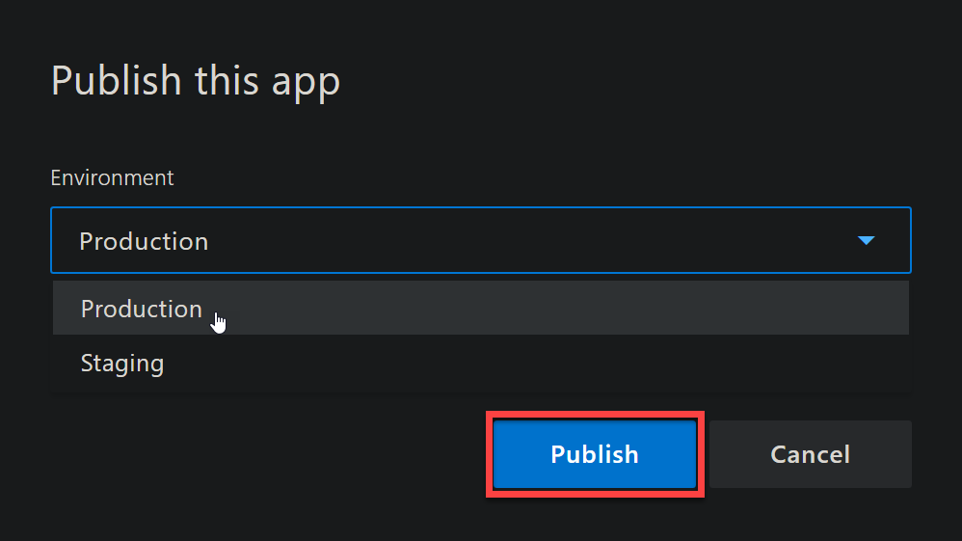
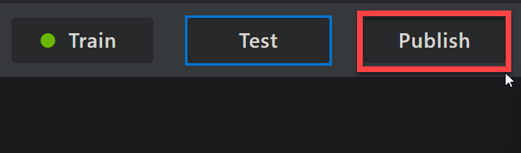
7. Publish the AI
AI

Slide 32
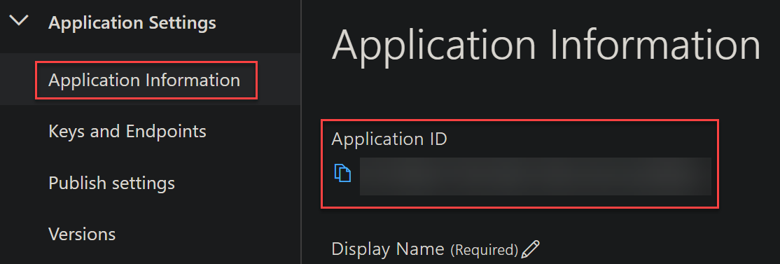
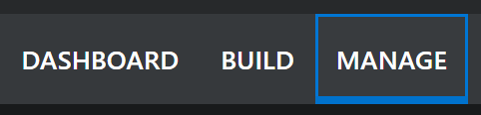
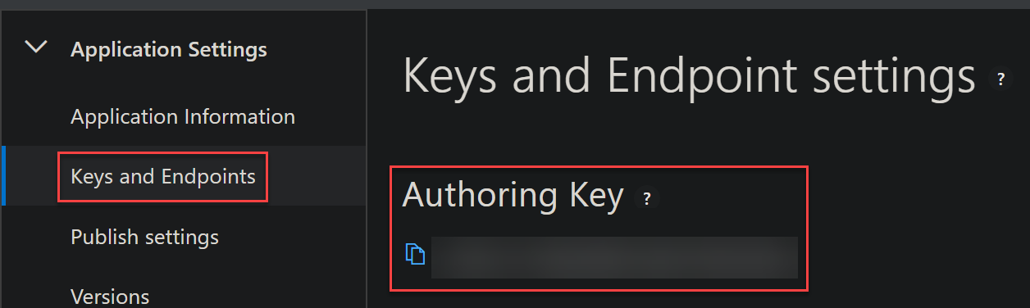
8. Gather App Information
AI

Slide 33
Bots

Slide 34
Bots

Slide 35
Bots
Bot Service

Slide 36
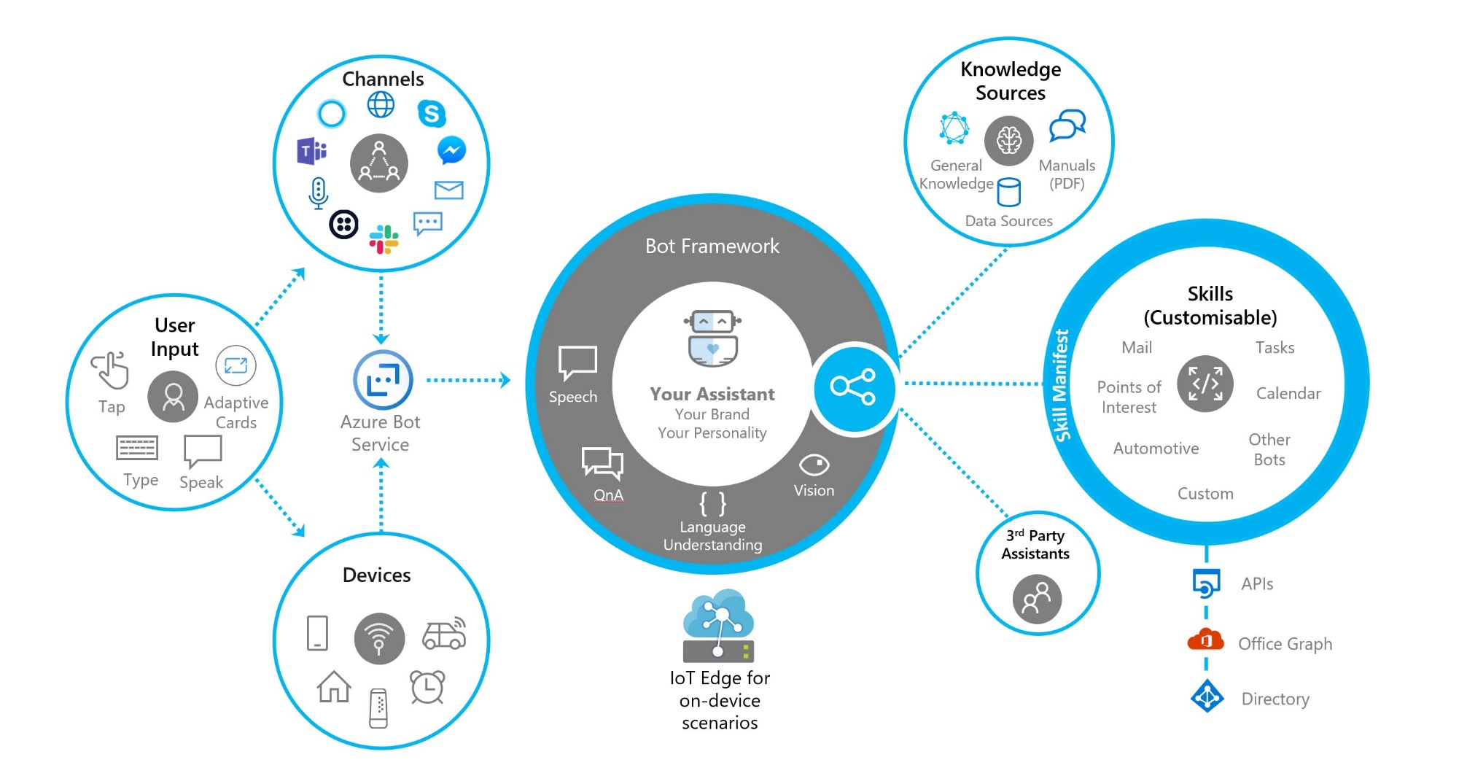

Slide 37
Bots

Slide 38
Bots

Slide 40
Demo

Slide 41
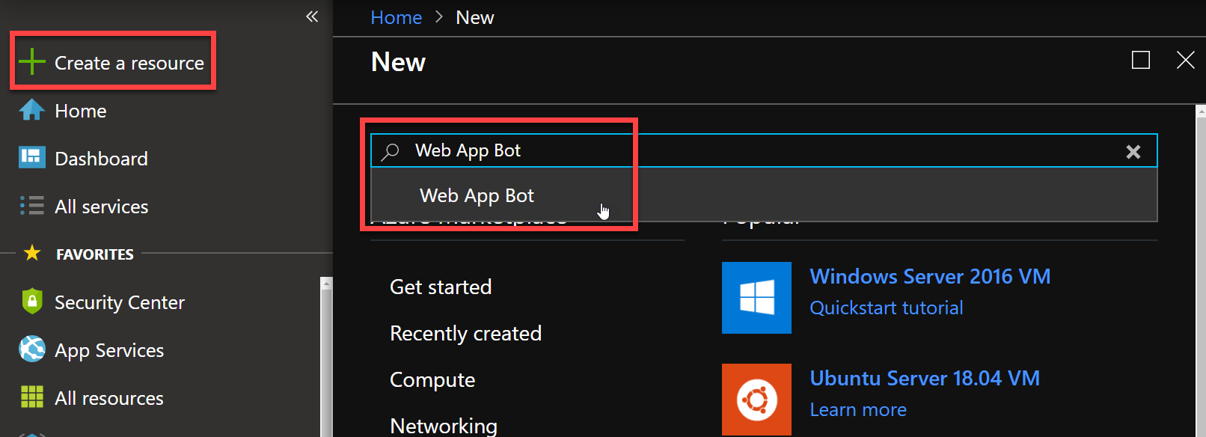
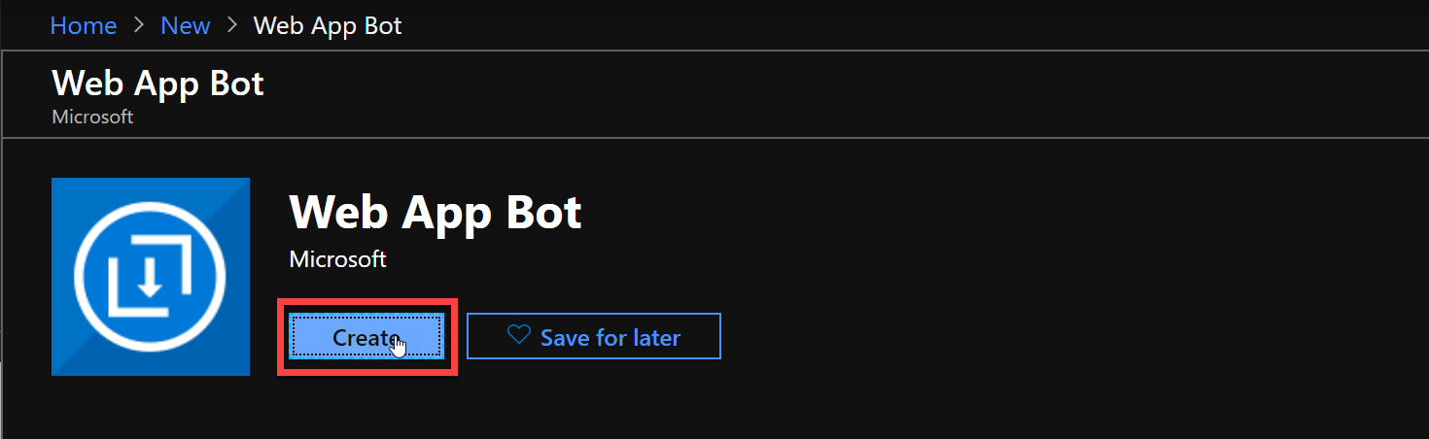
Bots
1. Create a new Bot

Slide 42
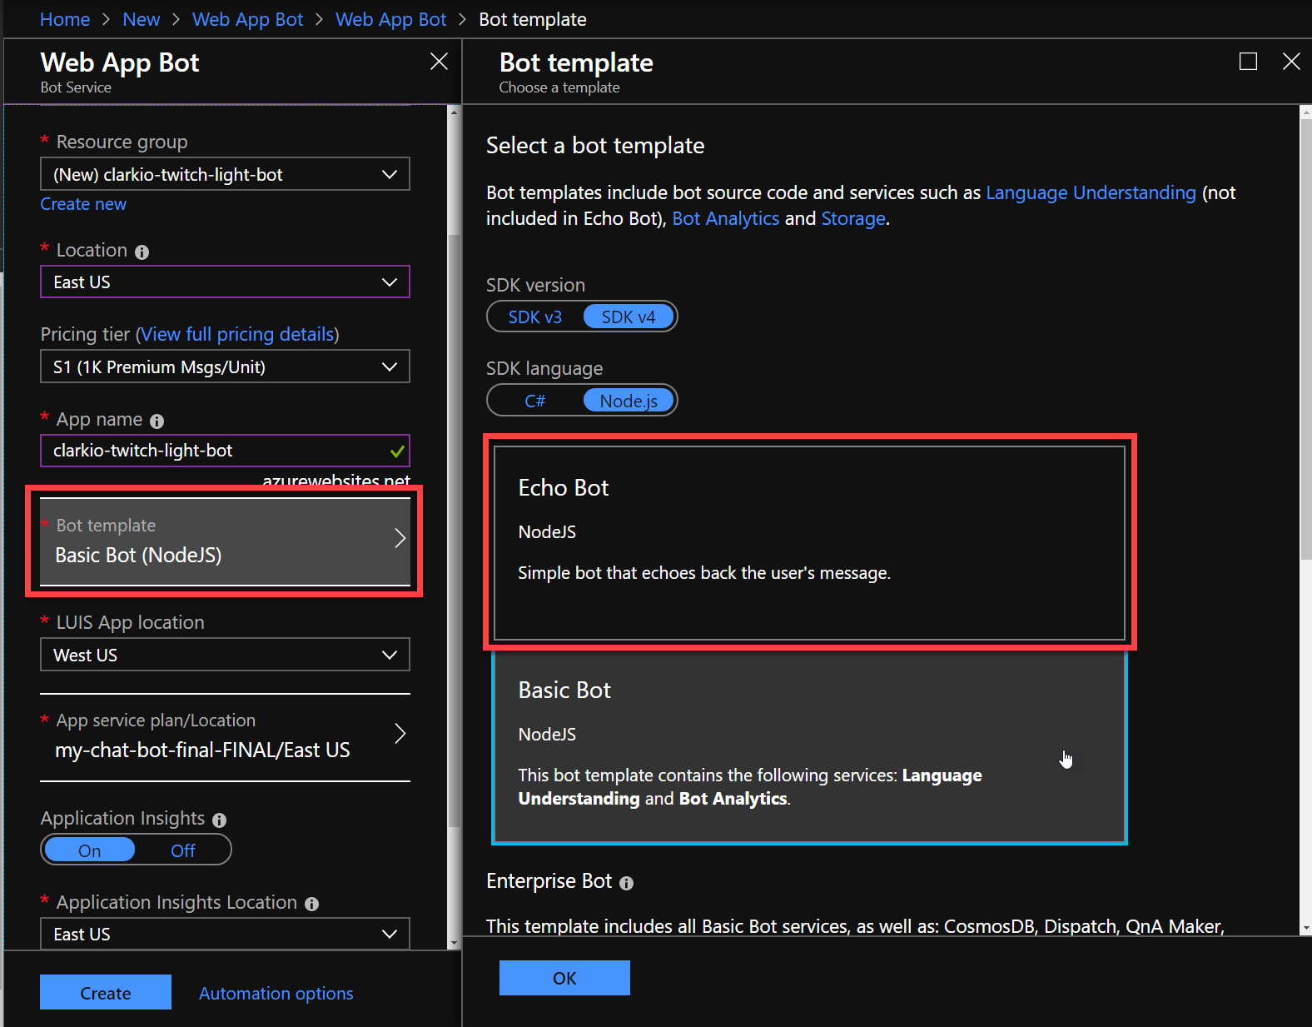
Bots
2. Choose a template

Slide 43
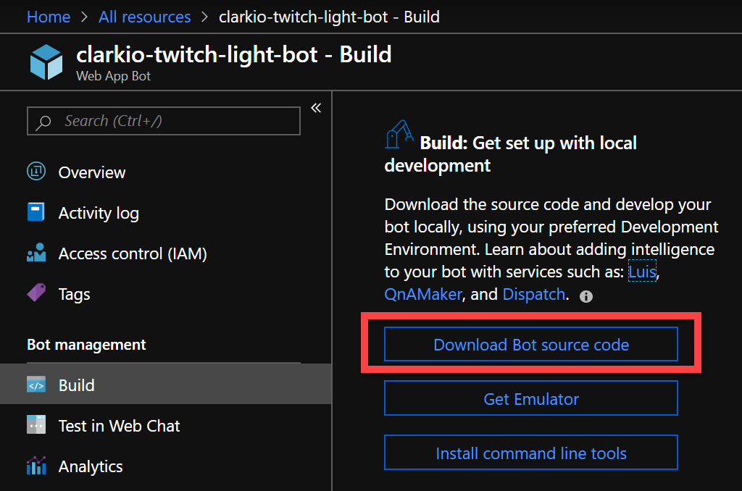
Bots
3. Download the source code

Slide 44
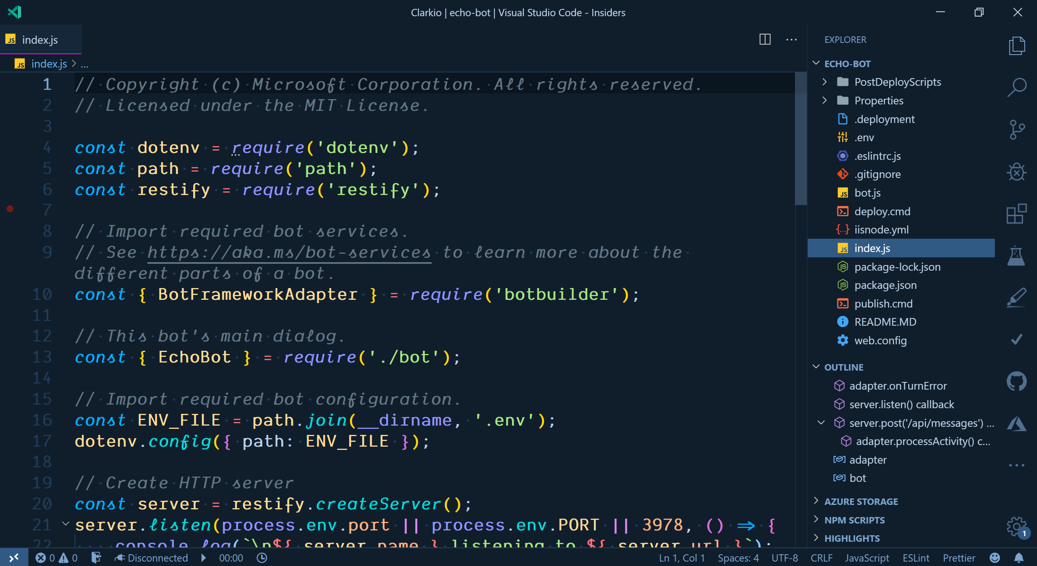
Bots
3. Download the source code

Slide 45
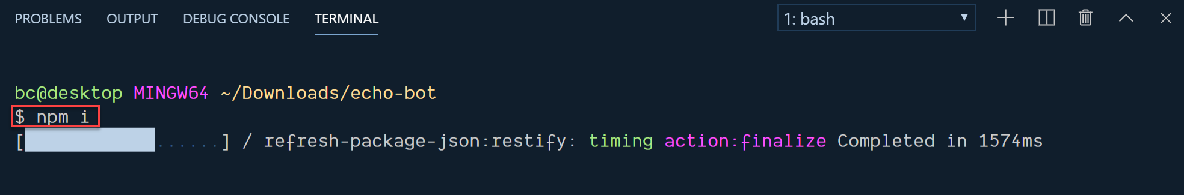
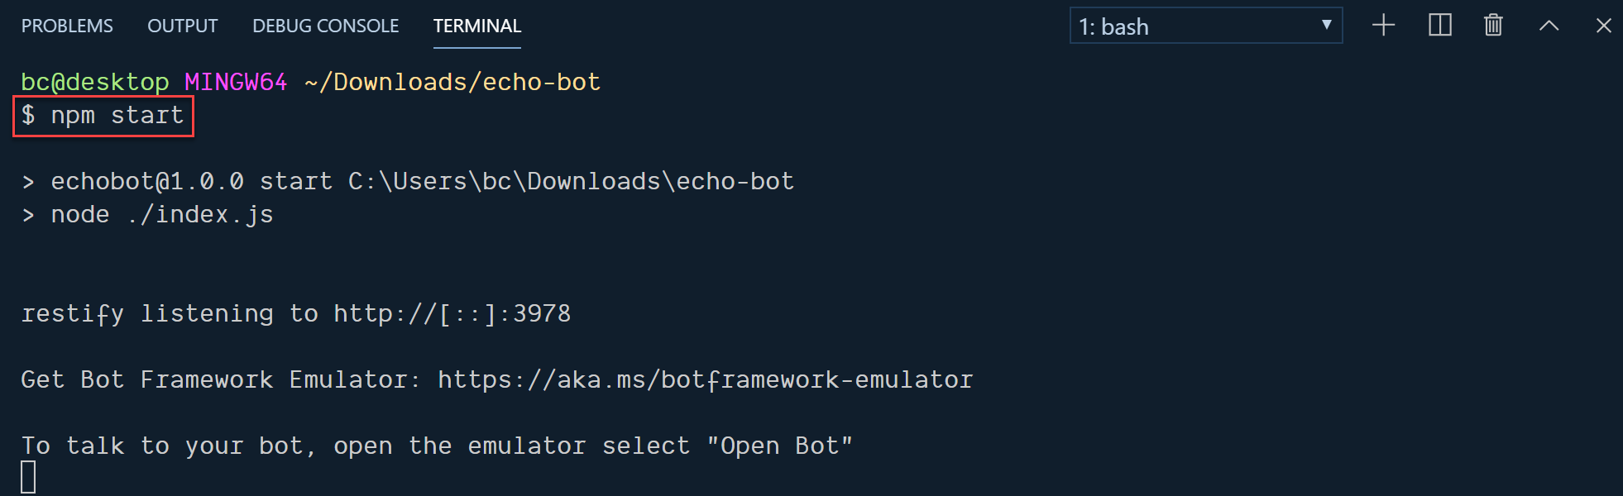
Bots
4. Install and run

Slide 46
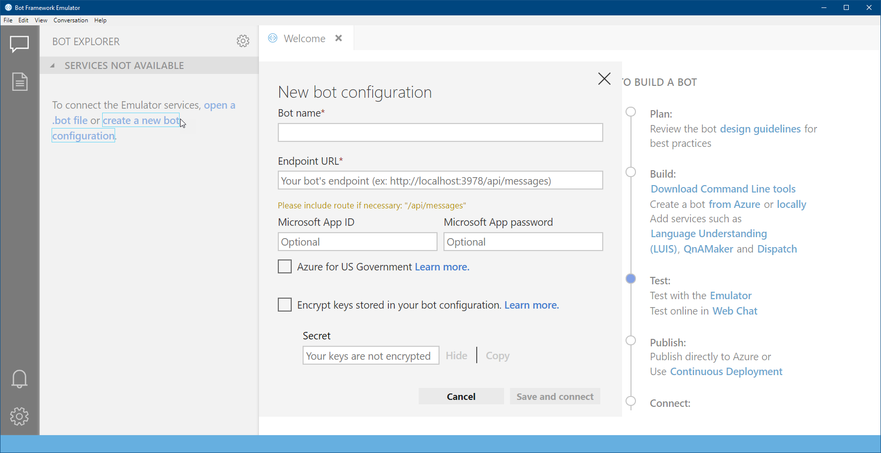
Bots
5. Bot Framework Emulator

Slide 47
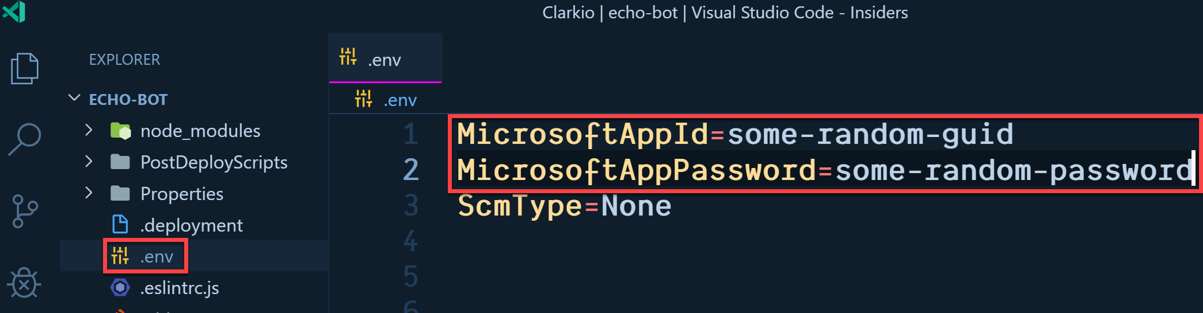
Bots
6. Add app connection information

Slide 48
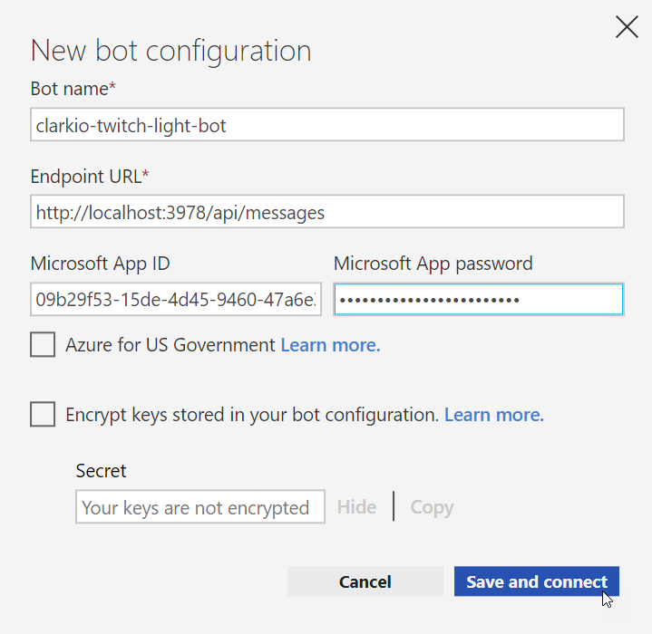
Bots
6. Add app connection information

Slide 49
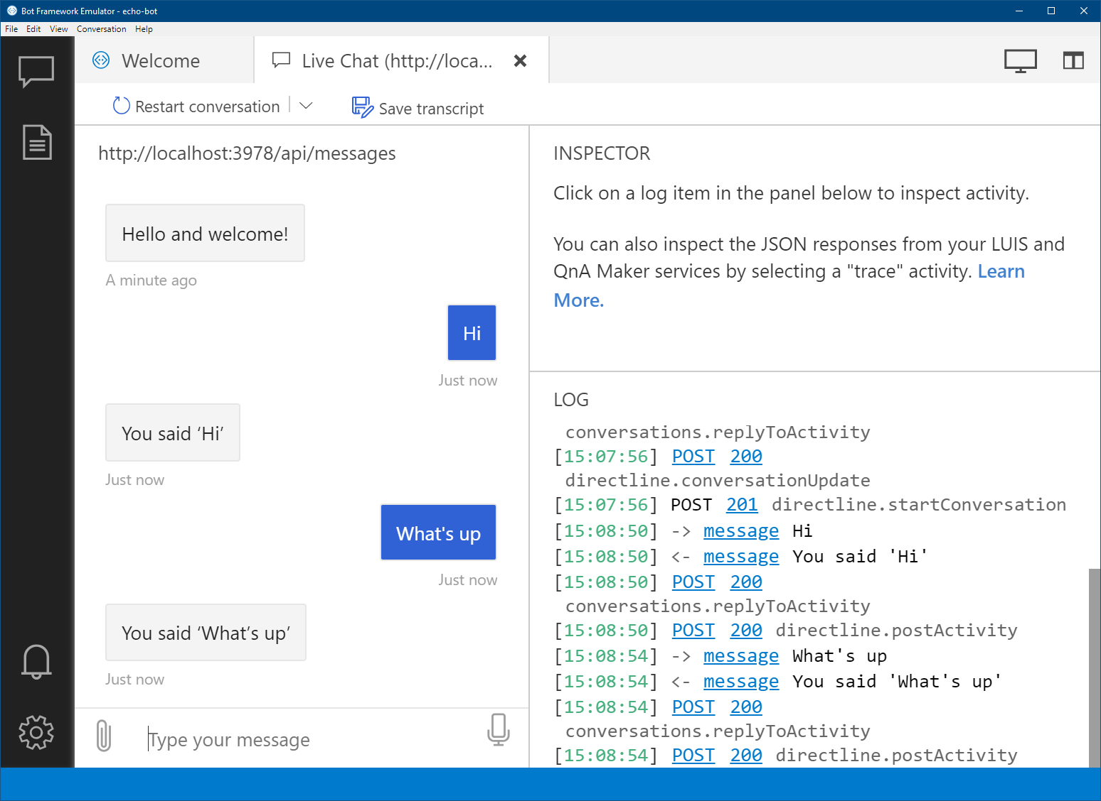
Bots
7. Test and debug

Slide 50
Connecting LUIS

Slide 51
1. Gather App Information
Connecting
LUIS

Slide 52
2. Update settings
Connecting
LUIS

Slide 53
3. Add LUIS helper file
Connecting
LUIS
Follow documentation for source code
or
See Twitch Light Bot source code

Slide 54
Solution Demo

Slide 55
Camera

Slide 56
Camera

Slide 57
Why Twitch?
Alternative Training
Experience New Tech
Connecting Remotely

Slide 59
Connect to the Bot
1. Add Direct Line Channel

Slide 60
2. Get Direct Line Channel Configuration
Connect to the Bot

Slide 61
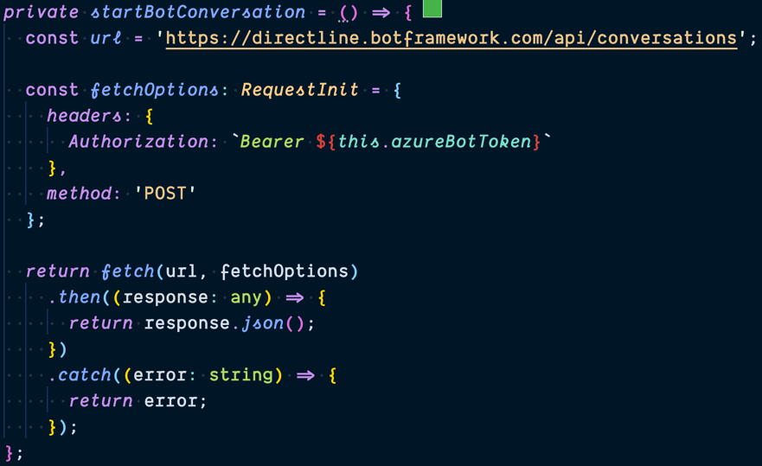
3. Start Bot Conversation
Connect to the Bot

Slide 62
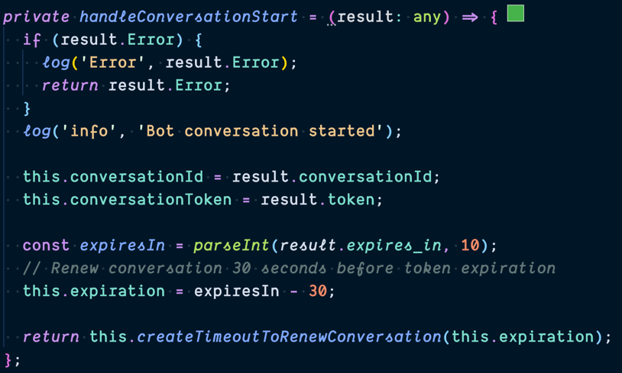
4. Capture Conversation Id and Token
Connect to the Bot

Slide 63
Connect to the Bot
Demo

Slide 64
Thanks

Slide 65
Thank You
Brian Clark
clarkio.com
_clarkio
clarkio

Slide 66
References
aka.ms/clarkio-lights-camera-ai
Brian Clark
clarkio.com
_clarkio
clarkio

Slide 67
Lights, Camera, AI
Brian Clark
_clarkio
clarkio

